Slide 1
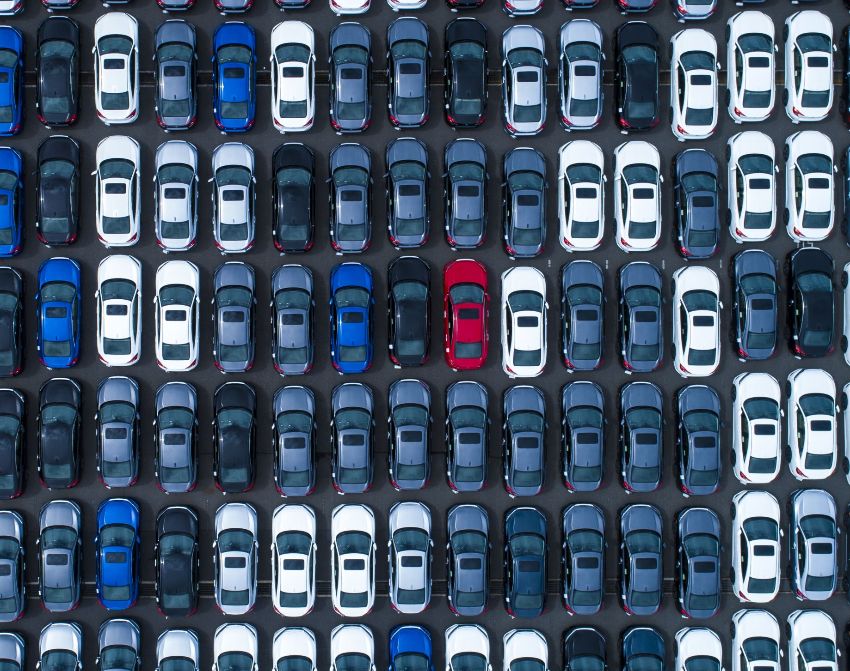
US Used Cars Analysis from September 2020
Authors: Brian Bao, Karen Alvarez, Natalie Sanchez, Shadman Sayef
Department of Information Systems, California State University
CIS 45601-01 Introduction to Big Data

Slide 2
Presentation Overview
Abstract & introduction
Related work
Specifications
Implementation of flowchart
Data cleaning
Analysis and Visualization
Conclusion

Slide 3
Dataset Overview: US Used cars dataset
3 Million US used cars
Total Records:
Contains over 3 million real-world used car listings
Key Attributes:
Vehicle Info: VIN, make, model, year, body type, engine type, fuel type
Pricing & Condition: Price, mileage, certification status, accident history, CPO status
Dealer Location: City, dealer ZIP code, geolocation (latitude/longitude)
Performance Metrics: Fuel economy (city/highway/combined), horsepower, fuel tank volume
Other Details: Exterior/interior color, bed size (for trucks), legroom, listing date, days on market
Unique Identifier:
Each car listing has a VIN (Vehicle Identification Number)
Purpose of Use:
Enables analysis of market trends, regional preferences, brand pricing, and consumer behavior in the used car industry

Slide 4
Predicting Patterns in the U.S. Used Car Market
Purpose of the Project:
To explore pricing trends, vehicle popularity, and regional market patterns using real-world used car listings
To apply big data tools for cleaning, processing, and visualizing a large-scale dataset
Why This Dataset?
It reflects real consumer behavior and vehicle characteristics across the U.S.
Rich features like fuel economy, mileage, accident history, and location provide many angles for analysis
Offers an opportunity to build data-driven insights or predictive models (e.g., price estimation)
Tools Used:
Hadoop & Hive for large-scale data processing
Excel & Power BI for interactive visualizations and reporting
Project Goals:
Clean and structure a complex, messy dataset
Uncover which features affect used car prices the most
Analyze geographic trends and brand performance
Create visuals that communicate insights clearly to both technical and non-technical audiences

Slide 5
Related Work
Supply Chain Disruptions (MIT)
Focuses on how automobile OEMs adapted supply chains.
Explains how supply chain issues affected new car production, and thus used car market.
Changes in Travel Behavior (CREDS)
Analyzes changes in UK travel patterns due to the pandemic.
Documents reduced overall travel and car traffic.
Notes the decrease in car ownership.
European Urban Mobility (JRC)
Examines post-pandemic trends in European urban mobility.
Explains increased car usage and slow recovery of public transport.
Discusses potential for increased car dependency.

Slide 6
Specifications (Dataset)
Dataset (from Kaggle): used_cars_data.csv
Size: 9.3 GB
Rows: 3,000,599
Columns: 66
Format: .csv
Field Delimiter: " , "
Data Types: STRING, FLOAT, INT, BOOLEAN
Link: https://www.kaggle.com/datasets/ananaymital/us-used-cars-dataset

Slide 7
Specifications (Hardware)
H/W Specifications:
OS: Linux
Architecture: x86_84
Linux CPU: AMD EPYC 7763 (64-Core)
CPUs Visible: 6 virtual cores
CPU Speed: 2.45 GHz
Memory: 31 GB
Storage: 388 GB
Nodes: 5 (2 Master, 3 Worker)
Worker Nodes: bigdaiwn0, bigdaiwn1, and bigdaiwn2
Hadoop Cluster Version: 3.1.2
SSH Connection: 144.24.46.199

Slide 8
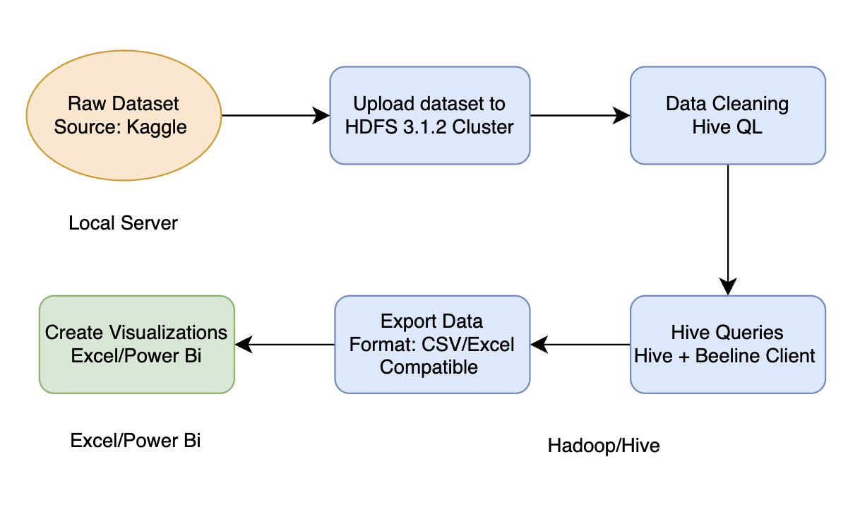
Used Car Data Analysis Flowchart

Slide 9
Data Cleaning
Dataset was downloaded as compressed .zip from Kaggle to local machine and uploaded to BigDAI Linux File Systems with scp command.
Command: scp used_car_data.zip [your_user]@144.24.46.199:~
UsedCars directory was created in HDFS to house dataset file.
Command: hdfs dfs –mkdir UsedCars
Dataset was unzipped and then put into Hadoop Distributed File System (HDFS) with unzip and put commands respectively.
Unzip Command: unzip used_car_data.zip -> (Produces used_cars_data.csv in Linux File System)
Put Command: hdfs dfs –put used_cars_data.csv UsedCars

Slide 10
Data Cleaning
Beeline Client was used to generate "master" table with all 66 columns using CREATE EXTERNAL TABLE command.
Beeline Client was used to generate "simple" table, retaining columns necessary for analysis with redundant/unnecessary columns removed.
Queries were run to generate data required for analysis and visualization.
"Simple" table was written to HDFS with INSERT OVERWRITE DIRECTORY.
Partitions were merged with hdfs dfs –getmerge into one .csv file.
New "used_cars_simple.csv" file can be downloaded to local machine with scp.

Slide 11
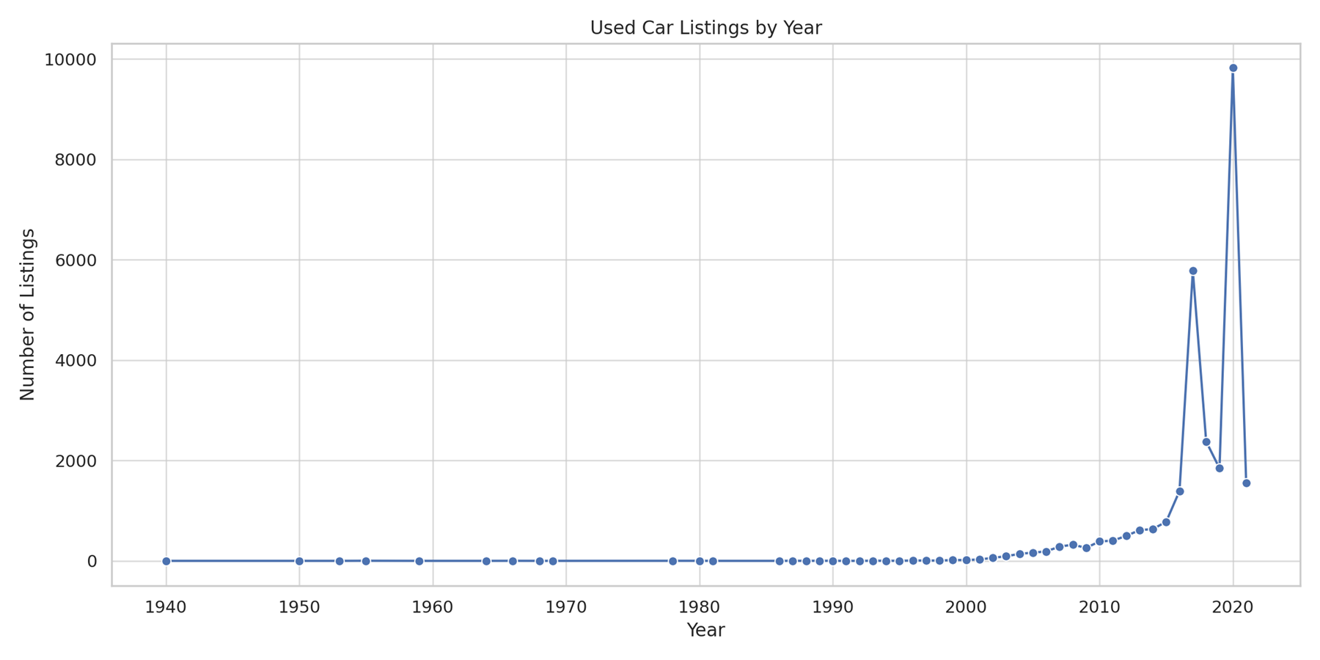
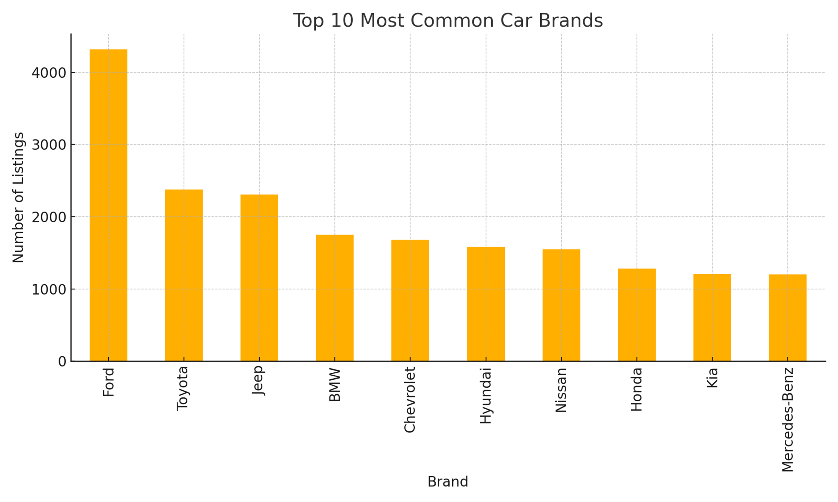
Analysis & Visualization
This line chart illustrates how many used cars were listed each year. There's a dramatic spike around 2020, likely due to the pandemic’s impact on new car supply and demand for used vehicles
This bar chart shows which car body types have the highest average prices. It helps identify which types are more valuable in the used market.

Slide 12
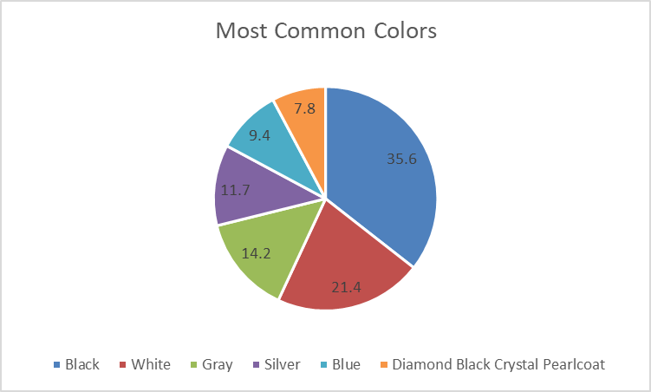
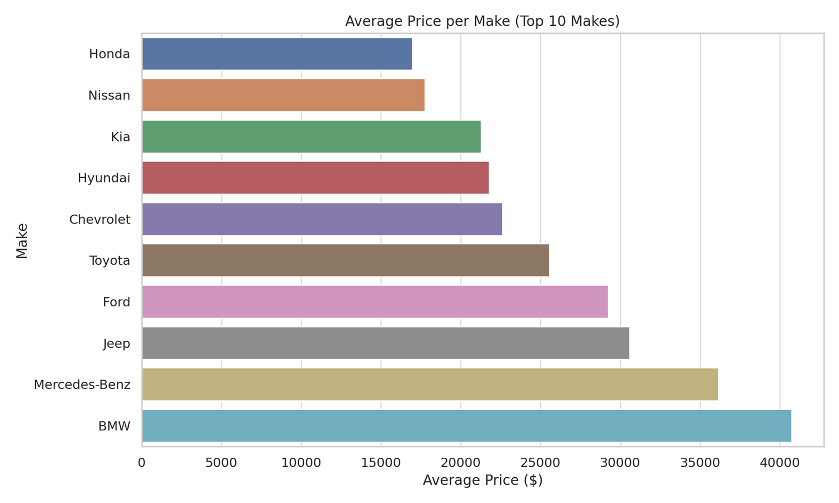
Analysis & Visualization
This pie chart shows the top 6 most popular car exterior colors. Black leads significantly with over 35% of listings, followed by White and Gray. This helps dealerships know which colors are in high demand.
This chart displays the average price of used cars by make. Luxury brands like BMW and Mercedes-Benz top the list, while makes like Honda and Nissan have lower average prices. It reflects both brand value and consumer affordability

Slide 13
Conclusion
A significant increase in used car listings occurred around 2020, likely driven by pandemic-related disruptions in new car supply and increased demand for used vehicles.
Certain car body types command higher average prices in the used market, indicating their greater value.
Black is the most popular exterior color for used cars (over 35% of listings), followed by White and Gray, highlighting key consumer preferences.
Luxury brands like BMW and Mercedes-Benz have the highest average used car prices, while more mainstream brands such as Honda and Nissan exhibit lower average prices.
The analysis provides a comprehensive view of used car pricing dynamics, vehicle popularity based on body type and color, and the influence of brand on market valuation in the US.

Slide 14
Work Cited
Dong, W. (2024, June 25). Strategic transformation trends within automobile supply chains in the Post-Pandemic Era. Strategic Transformation Trends within Automobile Supply Chains in the Post-Pandemic Era. https://dspace.mit.edu/handle/1721.1/156029
Anable, J., Brown, L., Docherty, I., & Marsden, G. (n.d.). Less is more: Changing Travel in a post-pandemic society. Less is more: Changing travel in a post-pandemic society. https://www.creds.ac.uk/wp-content/uploads/CREDS-Less-is-more-web.pdf
Christidis, P., Vega, G., Ulpiani, P., & Vetter, N. (2023). Post-pandemic trends in Urban mobility. Post-pandemic trends in urban mobility. https://mobispaces.eu/sites/default/files/2023-07/JRC133322_01.pdf

Slide 15
Resources
https://github.com/bbao3-csula/CIS-4560-Used-Cars

